Slide 1
Simmer
Style Guide

Slide 2
Asset Dimensions and Specifications:
(by pixels)
Characters:
Ingredients: 100 x 100 (prototype?)
Dishes:
Appliances:
Environment Tiles:
Background/Canvas: 1980 x 1080

Slide 3
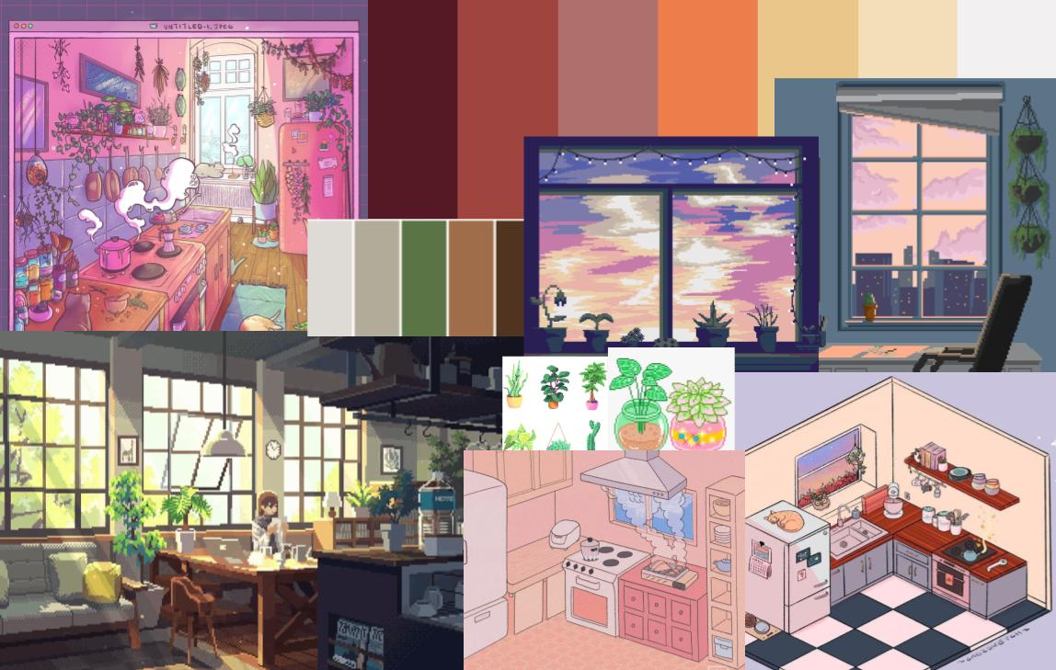
Color Palette & Tone/Mood
homey/warm - woody, looking over the city line
Greenery + plants that connect with nature
Lighting is desaturated sunny and warm - leaning towards yellows and oranges
Shadows are more saturated blues?

Slide 4


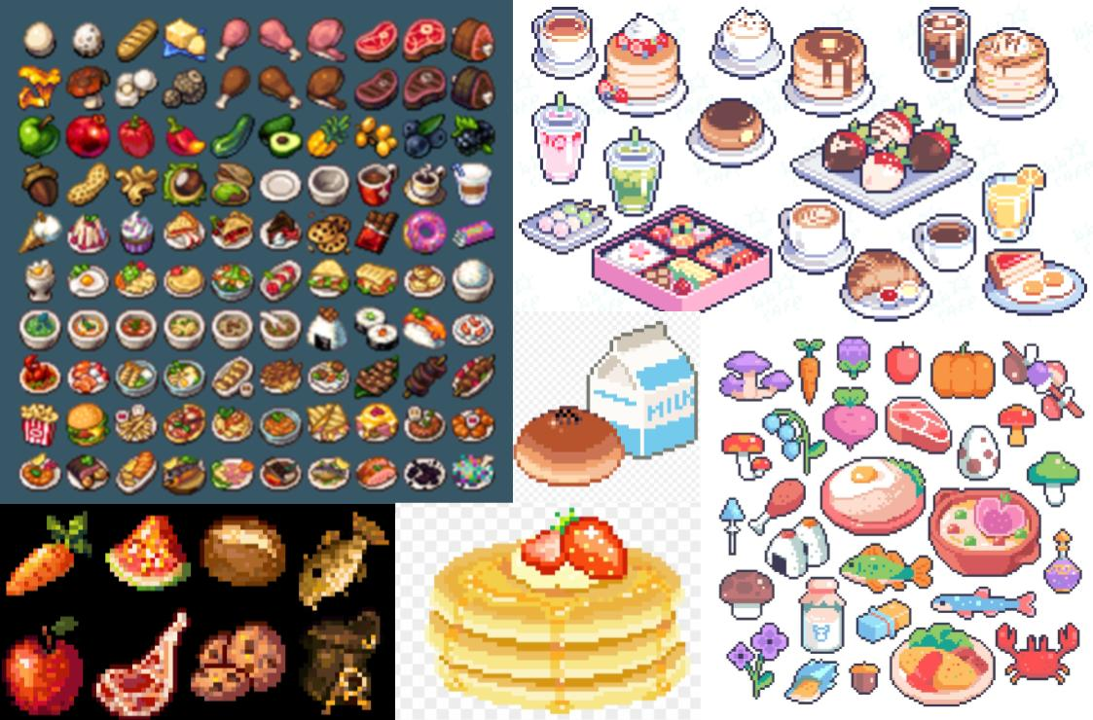
Food
Black outline to help distinguish food from environment
More detailed shading for dishes, minimal shading for ingredients

Slide 5
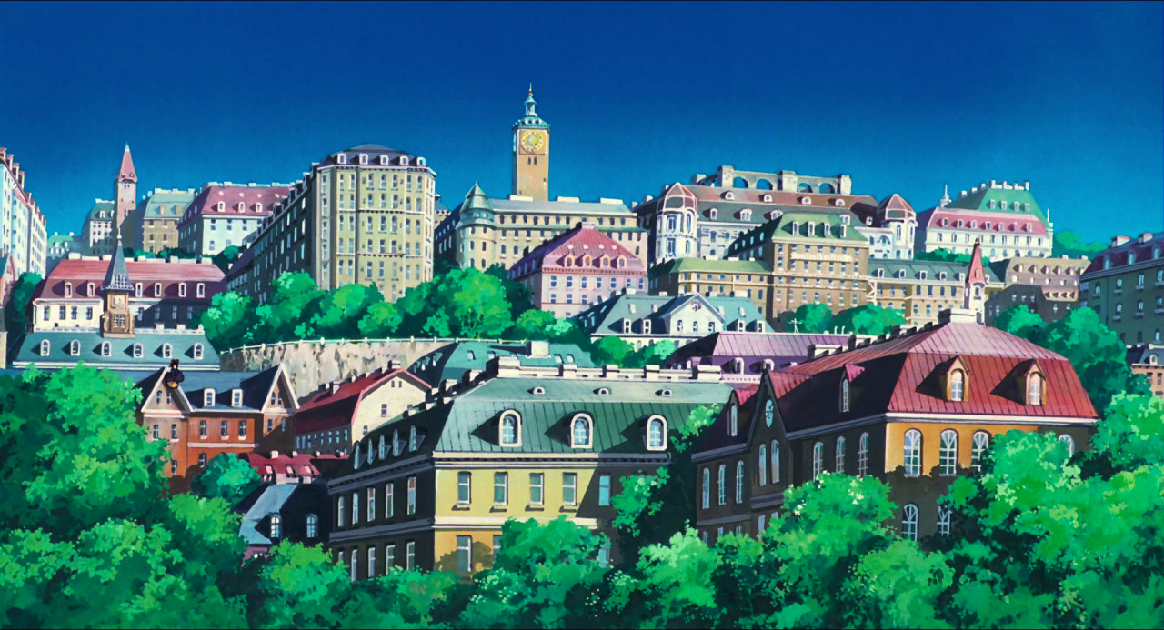
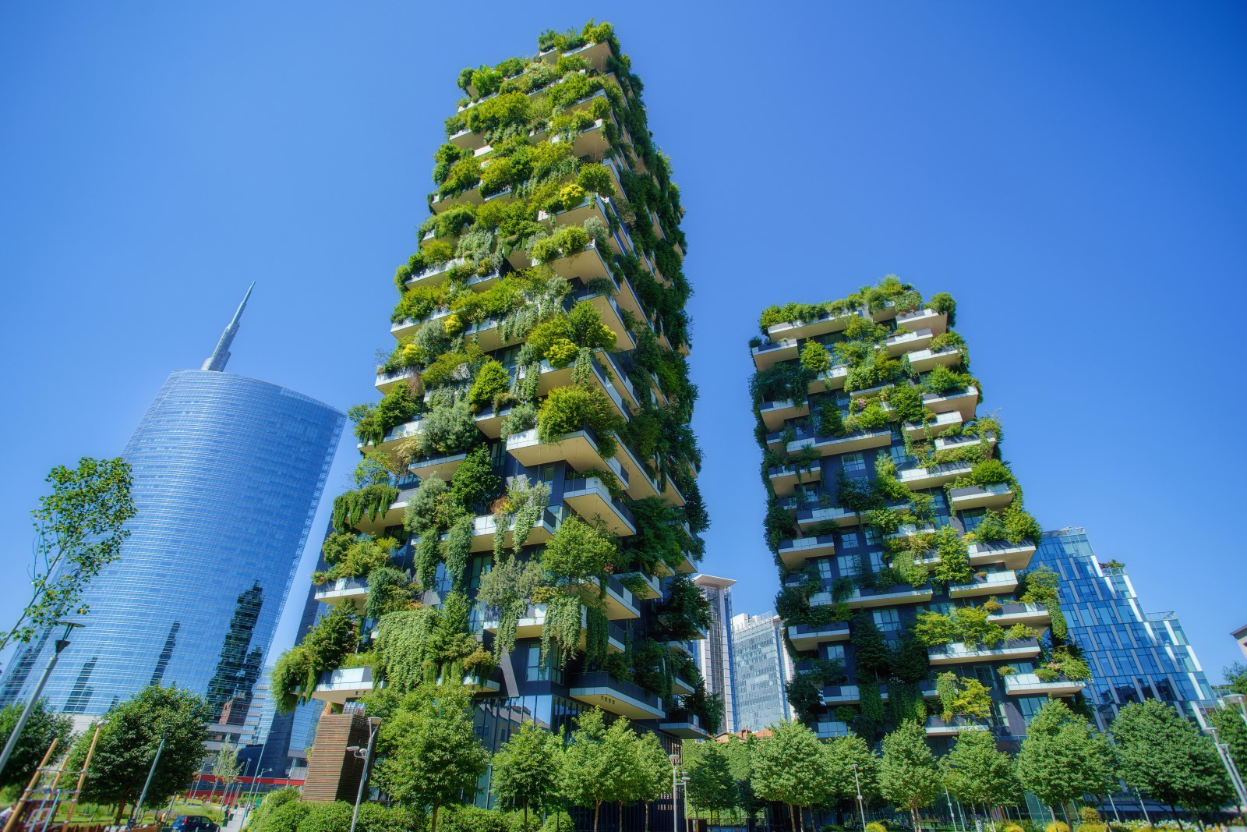
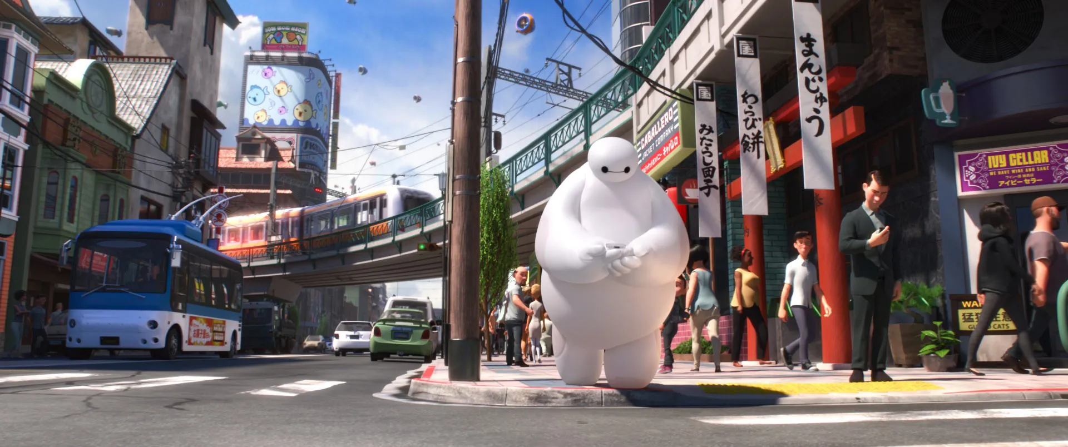
Setting
A city that has decided to embrace nature. As such trees and vegetation are quite common while the infrastructure for things such as the internet was deemed too destructive/disruptive and thus is almost nonexistent in the city.
The city is a mostly self-sufficient city. So despite its urban architecture and dense population small farms, vegetation, and parks are a very common site. The people in the city tend to mostly keep to themselves but there are smaller groups in the city that are more friendly/community oriented. The farmers market for one and the people in the apartment complex you recently moved into are friendlier than most.

Slide 6
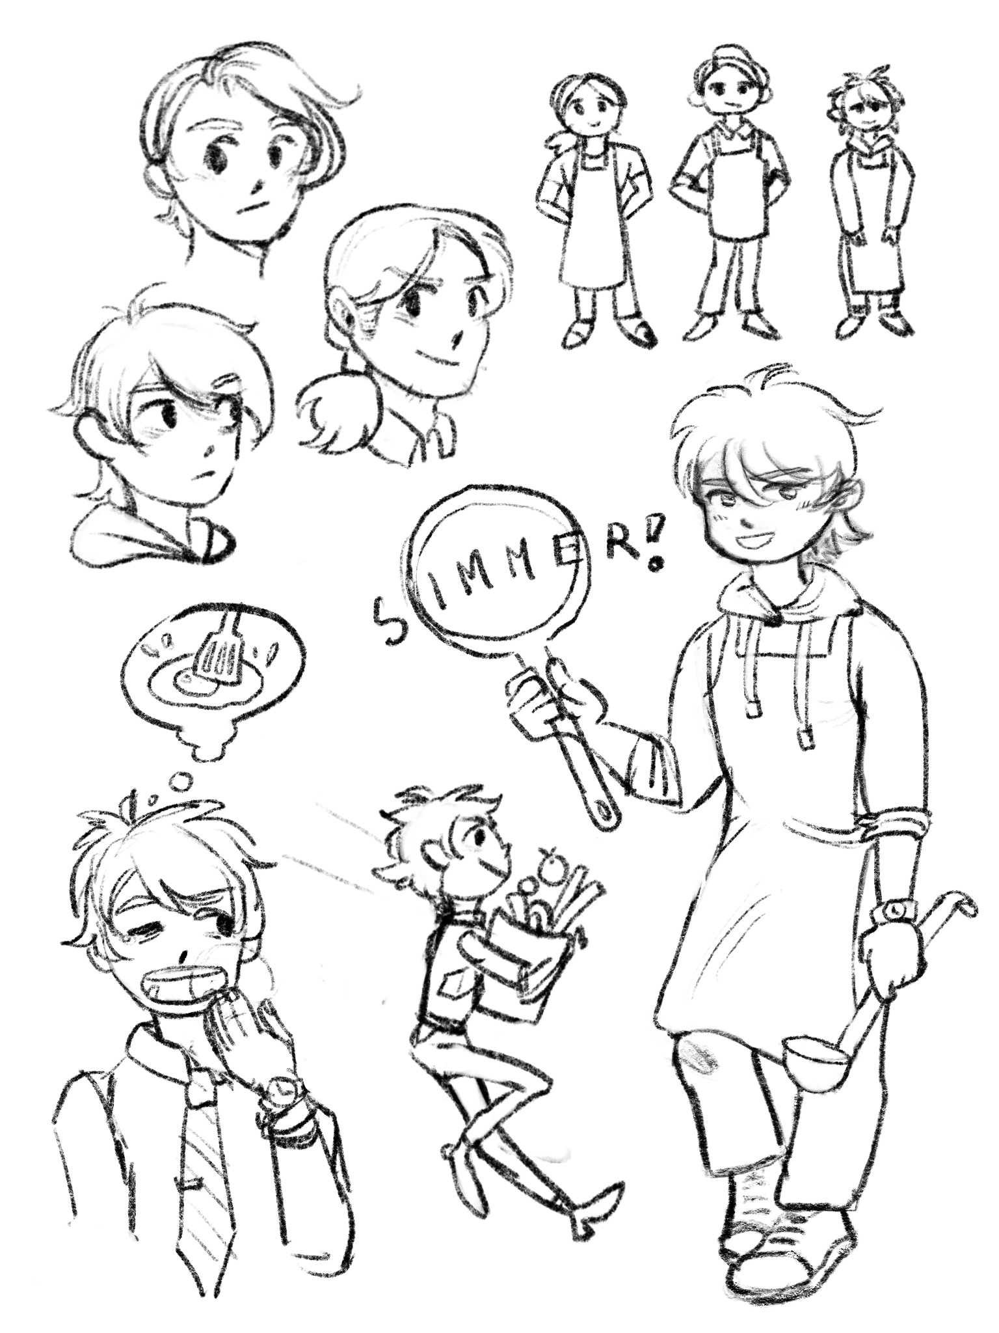
Character/NPC
Backstory
When you were younger you and your mother used to cook together all the time. Now years after she’s passed away cooking helps you still feel connected to her. Plus cooking your friends and neighbors their favorite dishes always makes them smile which makes you feel good. Not to mention it's a good distraction from the monotony of your dead end job.
Basis for tutorial!
You've been in this city your entire life but you realized recently that you don’t actually know anyone. You were always too busy studying to socialize and once you graduated you were so laser focused on your career that you never got to know any of your neighbors or co-workers. Now though since your career has hit a dead end and you've begun to kind of hate your job you feel lonely and kind of wish you had. Well it's never too late to start and nothing helps break the ice like a good meal.
You recently took up cooking because you find it fun. But you kind of suck at it to be honest. You can't hold a knife right and most of the stuff you try to cook ends up burnt. Even Toast, I mean how do you fuck up toast? Luckily the people at the farmers market and in your community have been really supportive of your new hobby even volunteering as taste tester for the next crime against cooking you make and giving you new recipes to try out.

Slide 7
Sound and Music

Slide 8
UI

